Slide 1

Instructions
The second slide provides a poster template for your reference. You may use it or create your own design. However, the size and title figure should not be modified.
Please prepare your poster in English, using more figures and fewer texts for better presentation.
The poster size is 120 × 90 cm. The figures in the poster should have a nice resolution for print.
Please submit your poster to yihnie@foxmail.com by April 21st. The conference organizers will print it for you free of charge.
Preferred Font：
Content | Font | Font Size
Title | Arial bold | 70
Authors | Arial bold | 45
Affiliations | Arial normal | 40
Headings | Times New Roman bold | 32
Main texts | Times New Roman | 32
Line space | 1.5

Slide 2
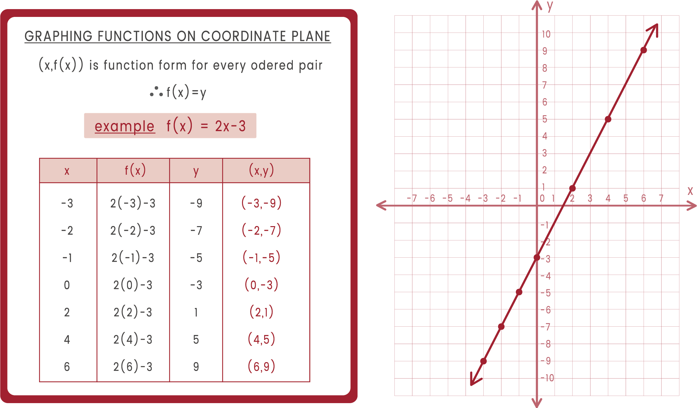
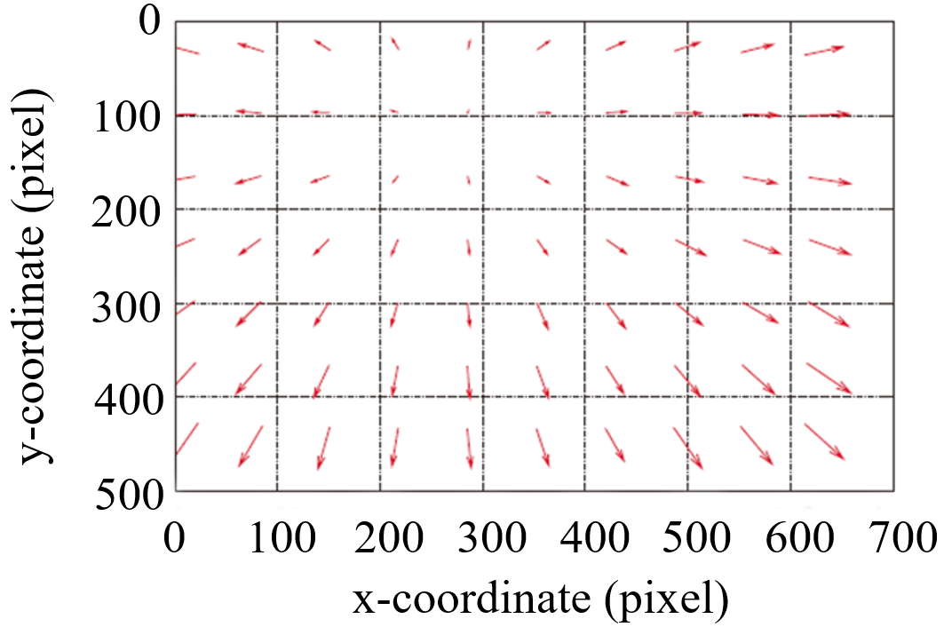
Paper Title
Name-A. Surname¹, Name-B. Surname², …
(¹First author’s affiliation, Country; ²Second author’s affiliation, Country; … )
Introduction
Texts
Texts
(a)
(b)
Fig. 1. ............：(a) .........^{[1]}，(b) ..........^{[2]}
Texts
(a)
(b)
Fig. 4 ....................................(a)...........(b)............
Conclusions
Texts
(a)
(b)
Fig. 2 .........................：(a) .....................(b) .....................
Texts
References
[1]
[2]
[3] .

